Slide 1
Home Away From Home
Student Housing Made Easier
Engineering 180 Project
Johanna Lopez, Vraj Parikh, Aaron San Jose, Lucio Perez

Slide 2
Purpose
To provide a tool that will simplify the process of finding affordable Off campus housing for incoming students. In addition to this, they will also be provided with information about what resources they will have access to if they select a certain area.

Slide 3
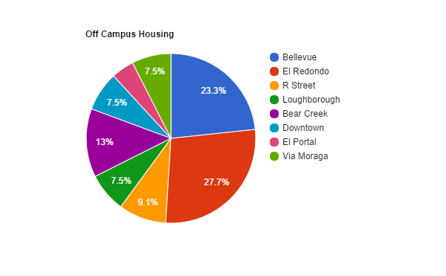
Survey Results
Based on a student survey, 27.7% of students live in El Redondo area.

Slide 4
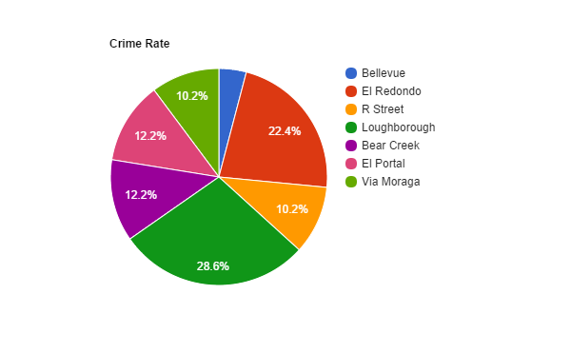
Crime Rate Results
Area with the lowest crime rate is Bellevue with 4.1% of crimes.

Slide 5
Analysis
El Redondo is the most populated with student housing, however it is also the second highest area of crime rates.
Bellevue is the second most populated area with student housing, and one of the areas with the least crime.
Loughborough is the area with most crime, however is one of the least student populated areas.

Slide 6
Resources
Google API: https://developers.google.com/maps/documentation/embed/
Crime Rates: http://www.crimemapping.com/map.aspx?aid=38fcd6f2-9412-4d6c-b19a-f3194549e926
How to make a web app: http://invisibleroads.com/tutorials/geodjango-googlemaps-build.html
How make a google map in HTML: http://www.w3schools.com/googleapi/google_maps_basic.asp
HTML Color Picker: http://www.w3schools.com/tags/ref_colormixer.asp
Google Maps JavaScript API V3 Reference: https://developers.google.com/maps/documentation/javascript/reference#SymbolPath
Customizing Google Maps: Adding a Custom Legend:https://developers.google.com/maps/tutorials/customizing/adding-a-legend

Slide 7
Questions?

